Slide 1
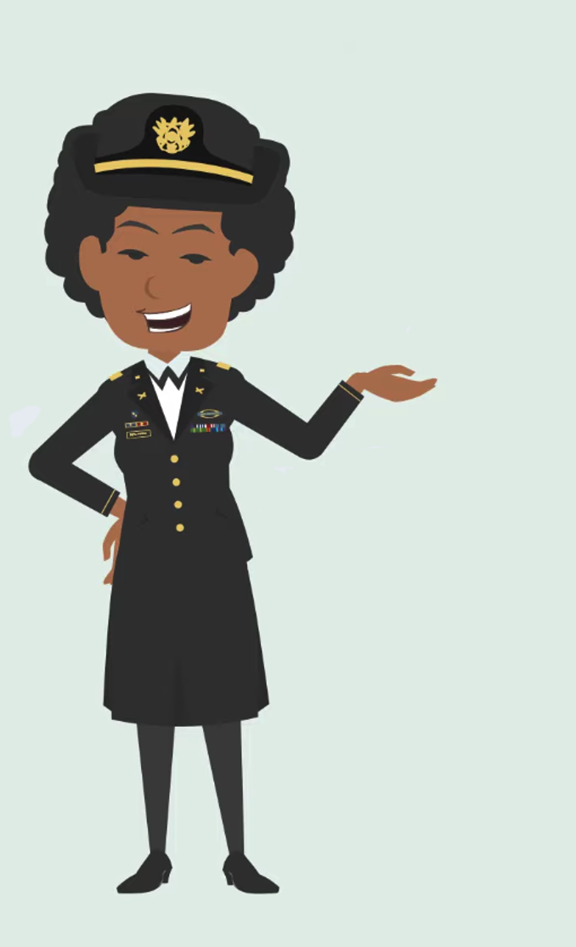
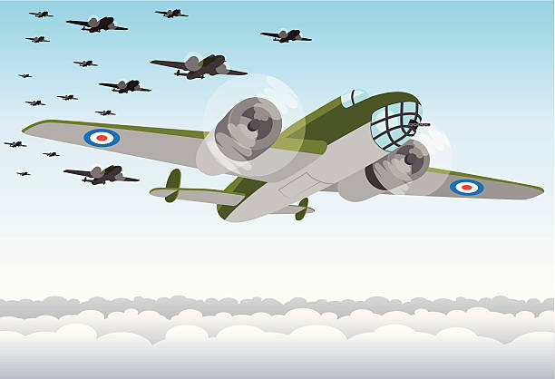
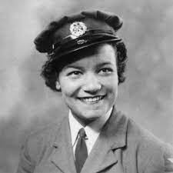
LILIAN BADER
KS2
She worked for RAF Shawbury, where she checked aeroplane instruments to make sure they were working right. Lilian was promoted to Acting Corporal. In 1943, met and married Ramsay Bader, who was a tank driver. Later, she became pregnant and had to leave her job at the Air Force. After the war, Lilian went to study at London University, where she got a degree and became a teacher. Lilian’s younger son followed her family’s traditions and became an airline pilot.
When World War II began in 1939, Lilian wanted to help out, so she got a job at a place called NAAFI where they served food to soldiers. But you know what? They asked her to leave because of the colour of her skin, which was not fair at all. But Lilian did not give up. In 1941, she decided to join the Women’s Auxiliary Air Force (WAAF) and learned how to fix aeroplane instruments. During her training, she heard some very sad news- her brother Jim, who was in the Merchant Navy, had lost his life at sea. But even with this sad news, Lilian completed her training and became one of the first women to do this job at the Air Force
Lilian Bader had a remarkable life story. She was born in Liverpool on 18th February 1917 (in some records it says that Lilian was born 1918). Her father was from Barbados and worked for the Royal Navy. Her mother was Irish but when Lilian was just nine years old, her parents passed away and she had to go and live at a convent.

Slide 2
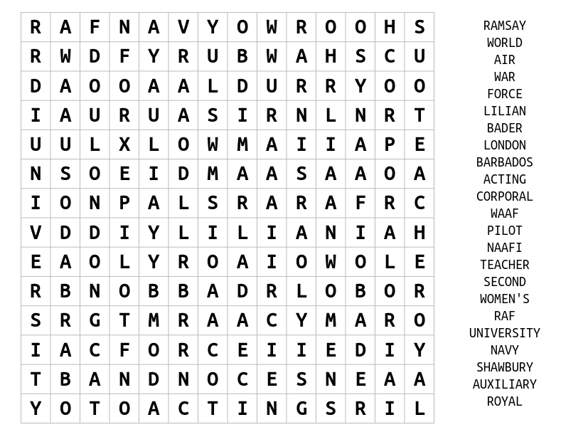
LILIAN BADER
KS2
WORKSHEET

Slide 3
LILIAN BADER
KS3
Faced with challenges, on March 28, 1941, Lilian volunteered to join the Women's Auxiliary Air Force (WAAF) and opted for training as an Instrument Repairer. During her training, she received heartbreaking news about her brother Jim, who served in the Merchant Navy and had tragically lost his life at sea. Despite this devastating loss, Lilian excelled in her training, earning a 'First Class' qualification, thus becoming one of the early women in the air force to specialise in that field. She was stationed at RAF Shawbury, where she tirelessly inspected and rectified faults in the aircraft instruments. Her competence and dedication led to her promotion to Acting Corporal
Lilian Bader, born Lilian Bailey on February 18, 1917 (some records show 1918), in Liverpool, her father was Barbadian and had served in the Royal Navy, while her mother was Irish. Tragically, Lilian lost her parents at the tender age of nine and was raised in a convent. As World War II erupted in 1939, Lilian initially found employment at a Navy, Army, and Air Force Institutes (NAAFI) canteen. However, her employment was short-lived due to racial discrimination, as she was asked to leave because of her Black heritage.
In 1943, Lilian met and married Ramsay Bader, a Black tank driver. Soon, she became pregnant, which led to her discharge from the WAAF in February 1944. After the war, Lilian pursued higher education and earned a degree from London University. She embarked on a career as a teacher, leaving a lasting impact on her students. Notably, her younger son followed in her family's tradition of aviation by piloting helicopters in the Royal Navy and later pursuing a career as an airline pilot. Lilian Bader's life story stands as a testament to her resilience in the face of adversity and her determination to excel in a time when racial and gender barriers were significant challenges.

Slide 4
LILIAN BADER
KS3
WORKSHEET
What Caribbean country was Lilian’s father from?
What was Lilian’s first job during the Second World War?
Why did Lilian have to leave that job?
Why do you think it took many years for women to gain roles in the war effort?
What course did Lilian have to pass to become an Acting Corporal?
Who was Ramsey Bader?
What was Ramsey Bader’s job?
What did Lilian Bader do after the Second World War?

Slide 5
LILIAN BADER
KS3
WORKSHEET

