Slide 1
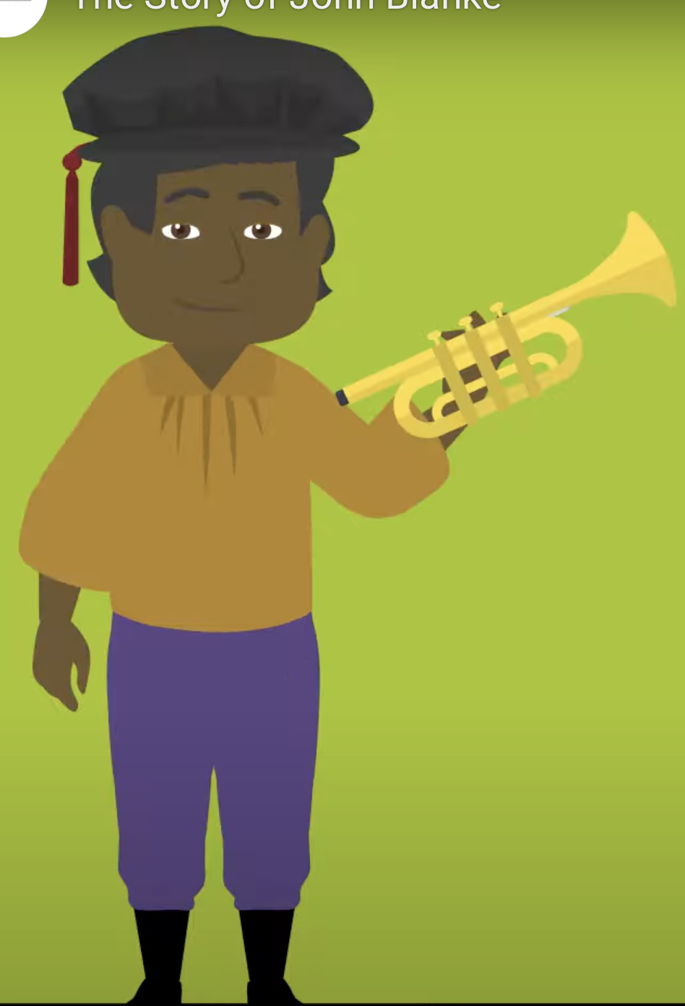
John Blanke
The Black Tudor
John Blanke was a historical figure from the Tudor period in England. He was a Black trumpeter who served in the courts of both Henry VII and Henry VIII, two significant monarchs in English history.
The first historical mention of John Blanke can be traced back to December 1507 when King Henry VII made a payment to him. At that time, John Blanke was one of eight royal trumpeters led by Peter de Casa Nova. According to records, he received a payment of 20 shillings for his services in November, at a rate of 8 pence (old currency) per day. It's believed that John Blanke might have initially come to England as part of the entourage accompanying Katherine of Aragon in 1501. Katherine was on her way to marry Prince Arthur, who was the eldest son and heir of King Henry VII. Among Katherine's entourage were a group of trumpeters, and shortly after her arrival, King Henry VII rewarded the "9 trumpets of Spain." It is worth noting that Catalina of Motril, a Muslim Moor and one of Katherine's servants in her bedchamber, was likely part of this contingent as well.

Slide 2
John Blanke
The Black Tudor
1. Henry VII (reigned 1485–1509): John Blanke is known to have worked as a trumpeter in the court of Henry VII. Records show that he was employed in the royal household and received a regular wage for his services. This suggests that he was a respected musician in the king's court during this period.
2. Henry VIII (reigned 1509–1547): John Blanke's association with Henry VIII's court continued into the reign of the next Tudor monarch. He is mentioned in historical records as receiving payments and a livery (a uniform or clothing provided by the royal household) for his role as a trumpeter in the court of Henry VIII.

Slide 3
John Blanke
The Black Tudor
John Blanke's presence in the Tudor courts is notable because it provides historical evidence of a Black individual occupying a respected and skilled position in the English royal court during a time when Black people were a minority in England. His story sheds light on the diverse and multicultural nature of Tudor England, as well as the importance of Black individuals in various facets of society, including the arts and music.
While John Blanke's role as a trumpeter may not have had a direct impact on the policies or significant events of the Tudor reigns, his existence challenges the misconception that Black people had no presence or influence in European history during this period. Instead, his story serves as a reminder of the rich tapestry of individuals who contributed to the cultural and social life of Tudor England.

Slide 4
John Blanke
The Black Tudor
Using this website: https://www.hrp.org.uk/tower-of-london/history-and-stories/john-blanke/ try and answer the following:
When did Blanke arrive in England?
How much money did Blanke earn a day?
How many times is Blanke featured in the tournament scroll?
How much money was his pay doubled to after asking for a pay rise from King Henry VII?

Slide 5
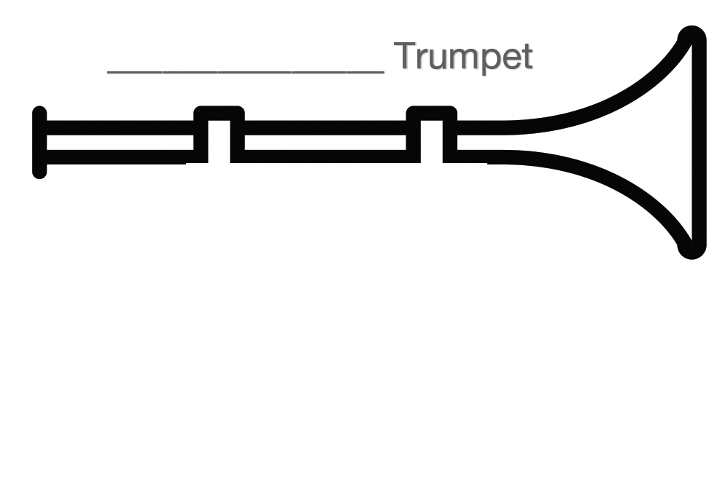
John Blanke
The Black Tudor
Design your own Trumpet:

