Slide 1
KS2
The Bristol Bus Boycott, which happened in England in the 1960s. It was like a big protest to fight against unfair rules about who could work on buses and how people of different backgrounds were treated. Back then, Bristol had many people who came from places like Africa, the Caribbean, and South Asia. But sadly, some people were treated unfairly because of the colour of their skin. The bus company in Bristol, where people could work as drivers and conductors, didn't let anyone who wasn't white do these jobs. This meant many people from different backgrounds couldn't get these good jobs.
Imagine you lived in Bristol during the 1960s, and you or your family members faced this unfair treatment. How would you feel, and what would you want to do to make things fair for everyone?

Slide 2
KS2
One group of brave people, including Paul Stephenson and some young men like Roy, Owen, Audley, and Prince, decided to take a stand against this unfairness. They formed a group called the West Indian Development Council. They wanted to change these unfair rules, so they decided to boycott the buses. A boycott is like when you and your friends decide not to do something you usually do to show that something is wrong.

Slide 3
KS2
In this case, they decided not to ride the buses until the rules changed. It was a way to tell the bus company that they needed to treat everyone equally. The boycott started in April 1963, and a lot of people joined in, both from the Black and White communities. They wanted to stop the discrimination and make sure everyone could work on the buses, no matter where they were from or what they looked like. Their actions got a lot of attention from the newspapers and even politicians. People all over the country started talking about what was happening in Bristol. This pressure made the bus company and the government change the rules. They said that everyone, no matter their background, could work on the buses.

Slide 4
KS2
This boycott was a big step in making sure everyone was treated fairly and equally. It helped change the laws to make sure people couldn't be treated unfairly because of their race. It showed that when people come together to stand up for what's right, they can make a difference.

Slide 5
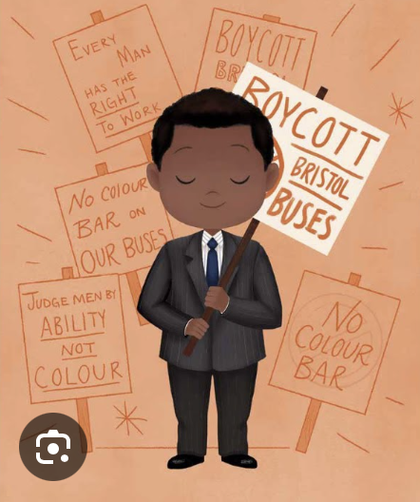
KS2 WORKSHEET
Create a poster about the Bristol Bus Boycott. In this post you should include information you think is important such as who were the members of the party?

Slide 6
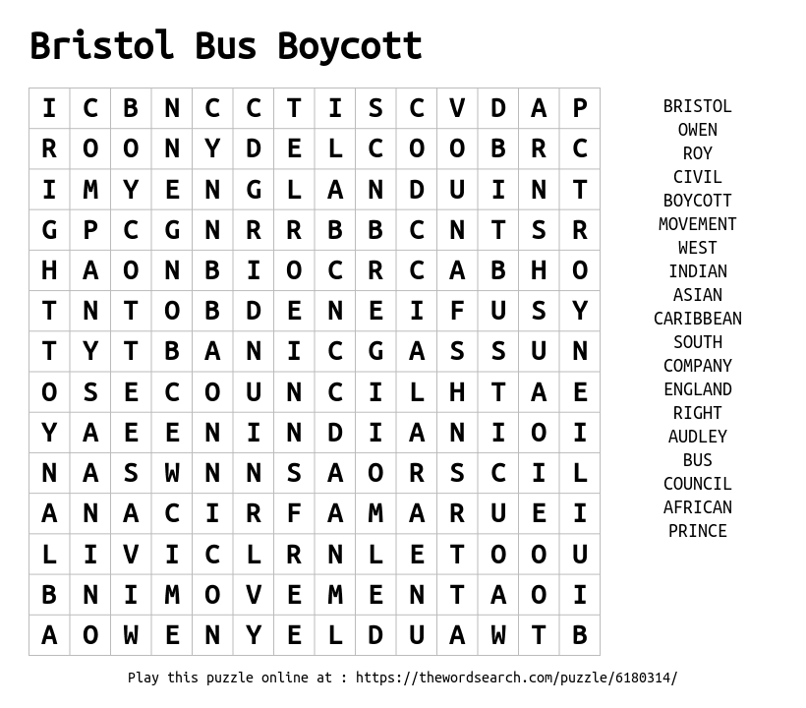
KS2 WORKSHEET

Slide 7
KS3
The Bristol Bus Boycott was an important civil rights campaign that took place in Bristol, England, in the 1960s. It was an important moment in the history of race relations in the United Kingdom and played a crucial role in challenging racial discrimination and segregation in public transportation. Background: In the 1950s and 1960s, Bristol had a significant immigrant population, including people of African, Caribbean, and South Asian descent. However, racial discrimination was prevalent, and one area where it was particularly visible was in the hiring practices of the Bristol Omnibus Company. The company refused to employ non-white workers as bus drivers or conductors, limiting job opportunities for the minority communities in the city. During the early 1960s, Bristol was home to approximately 3,000 residents of West Indian origin, comprising individuals who had served in the British military during World War II and recent immigrants to Britain.

Slide 8
KS3
Unfortunately, they faced all of discrimination in both housing and employment, with some members even falling victim to violence instigated by Teddy Boy gangs consisting of white British youths. In response to these challenges, the West Indian community established their own churches and associations, notably the West Indian Association, which began to function as a representative body. One of the most injustices within this community was the implementation of a "colour bar" by the Bristol Omnibus Company.

Slide 9
KS3
This company, which had been nationalised and was under British government ownership since 1950, operated through the Transport Holding Company. Despite reported labour shortages on buses, Black individuals seeking employment were consistently denied opportunities as bus crews, even though they were employed in lower-paying roles within workshops and canteens. The issue of the colour bar had gained attention in local newspapers, such as the Bristol Evening Post and the Western Daily Press.

Slide 10
KS3
The Bristol Bus Boycott found its roots in the collective efforts of four young West Indian men: Roy Hackett, Owen Henry, Audley Evans, and Prince Brown. Together, they formed an action group that later became known as the West Indian Development Council. Their motivation arose from a sense of frustration with the West Indian Association's perceived lack of progress in combating racial discrimination.

Slide 11
KS3
The Boycott: The Bristol Bus Boycott was sparked by the actions of Paul Stephenson, a young Black man who had recently moved to Bristol. In 1963, Stephenson applied for a job as a bus conductor with the Bristol Omnibus Company and was denied employment solely because of his ethnicity. This blatant discrimination prompted Stephenson to take action. Stephenson organised a boycott of the company's buses, urging the Black and White communities in Bristol to join together in protest. The campaign called for the end of racial discrimination in employment and service provision by the Bristol Omnibus Company. The boycott began on April 29, 1963, and received widespread support from the local community, activists, and even some sympathetic members of the press.

Slide 12
KS3
Impact and Resolution: The Bristol Bus Boycott attracted national and international attention and put significant pressure on the bus company and local authorities to address racial discrimination. The campaign was ultimately successful, and the Bristol Omnibus Company ended its policy of racial segregation in employment. In August 1963, the company employed its first black conductor marking a significant victory for the civil rights movement in the UK. The Bristol Bus Boycott in 1963 emerged as a response to the Bristol Omnibus Company's discriminatory policy of not hiring black or Asian bus crews in Bristol, England. During this period, racial discrimination against people of colour was pervasive in various aspects, including housing and employment, much like in other British cities.

Slide 13
KS3
This movement was spearheaded by Paul Stephenson, a youth worker, and the West Indian Development Council. Bristol residents rallied behind the cause, refusing to patronise the company's buses for an extended four-month period. Their persistence ultimately forced the company to abandon its discriminatory practices and lift the racial barriers it had imposed. The Bristol Bus Boycott gained national prominence, shedding light on the issue of racial discrimination within Britain. It received support from prominent national politicians, church groups, and even the High Commissioner for Trinidad and Tobago. Some consider this boycott to have played a pivotal role in the passage of the Race Relations Act of 1965, which prohibited racial discrimination in public places, and the Race Relations Act of 1968, which expanded these provisions to encompass employment and housing, marking significant steps towards combating racial discrimination in the United Kingdom.

Slide 14
KS3 WORKSHEET
Exercise 1: True or False
Read the following statement about the Bristol Bus Boycott and decide if it's true or false based on the information provided:
"During the 1960s, Bristol had an estimated 3,000 residents of West Indian origin, and they did not face any discrimination in housing or employment."

Slide 15
KS3 WORKSHEET
Exercise 2: Discussion Question
Imagine you are a member of the West Indian community living in Bristol during the 1960s. You've just learned about the Bristol Bus Boycott and the discrimination faced by your community. How would you feel about the situation, and what actions do you think you might take to address the issue of racial discrimination in public transportation?

Slide 16
KS3 WORKSHEET

